Slide 1

Bangladesh Army University Of Science And Technology
Department of Computer Science and Engineering
Steel Defect Detection With High- Frequency Camera Images
Supervisor :
Taher Muhammad Mahdee
Designation :
Asst. Professor,
Department of Computer Science & Engineering
Presented By :
Md Abir Hasan(170201063)
Mihir Roy (170201028)

Slide 2
Presentation Outlines
Introduction
Motivation
Description of Problem
Related Work
Intended Outcome
Method
Dataset and feature
Flow Chart
Step Analysis
Result Analysis
Conclusion
Future Work
References

Slide 3
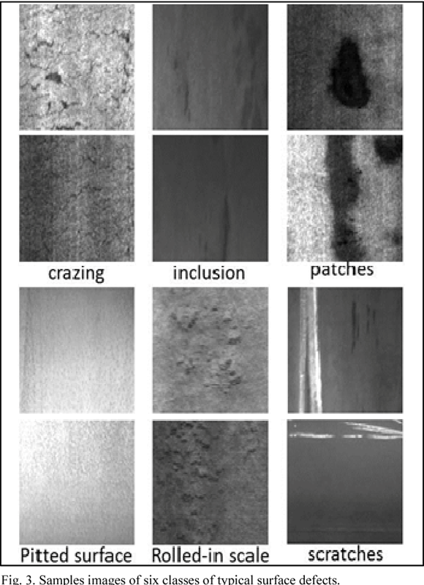
Introduction
What is Steel defect and how it occurs?
Production process of flat steel
Heating and Rolling
Drying and Cutting
steel sheets need to undergo careful inspection
localizing and classifying surface defects
Fig 1: Defects

Slide 4
Motivation
This project is targeted to find efficient and how much it can detect defect.
Main goal is to find good accuracy of detection.
Find a easy detection process for production / industry.
For produce pure defectless steel sheet.

Slide 5

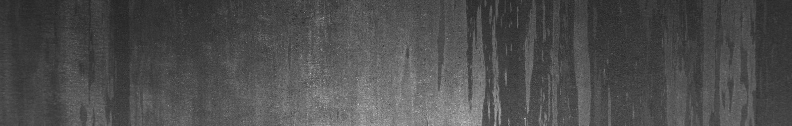
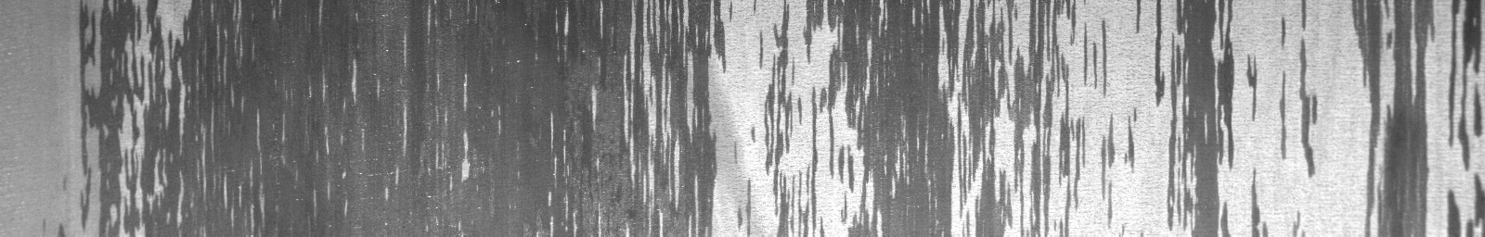
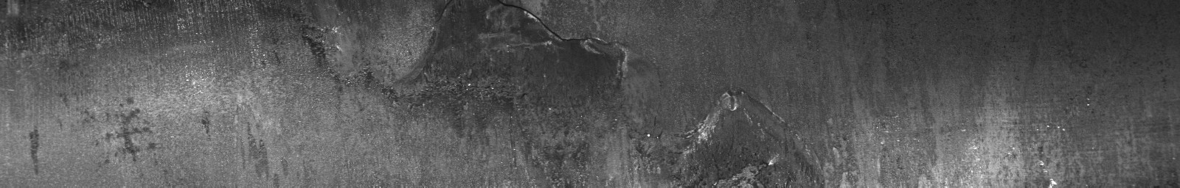
Description of Problem
Problem in production process.
Surface defect because of heating, rolling, drying and cutting a steel sheet.
Scratch
Inclusion
Pitted surface
Rolled in scale

Slide 6
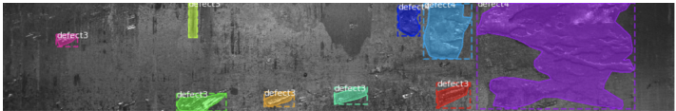
Related Work
Semantic Segmentation
CNN - Based Method (FCN)
Instance Segmentation
Proposal Based Method (Mask R-CNN)
Segmentation Based Method

Slide 7
Intended Outcome
To find efficient model for detect defect from image.
To achieve good accuracy of detection.
To learn how algorithms are working.

Slide 8
Method
We used these methods for this thesis
Neural Network
CNN
Xception
Clustering
KNN
Classification
SVM
Random Forest

Slide 9
Dataset and feature
Dataset Collected from PAO Severstal (A vertically integrated steel and steel-related mining company,Russia)
Images provided are of size 1600 × 256 × 1 and totals 12568 counts.
5902 images are with defects and 6666 images are without defects.
We flatten all the images for use of this project. So there are large number of feature.
We used 3100 data samples for this process.

Slide 10
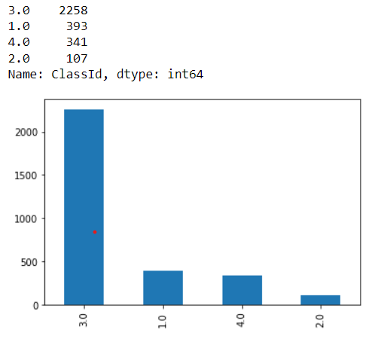
Dataset and feature
Datas are classified in 4 classes
for 4 type of steel defect.
Split Dataset
Train Data 80%
Test Data 20%
Fig 2: Data Classes

Slide 11
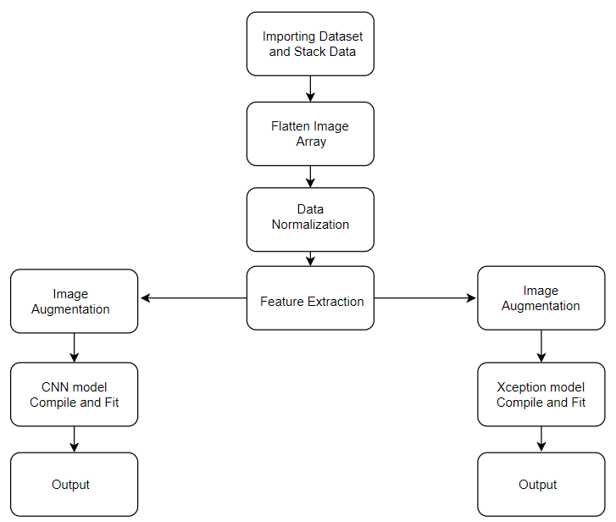
Flow Chart
CNN
Xception
Fig 3: Flow Chart For Neural Network

Slide 12
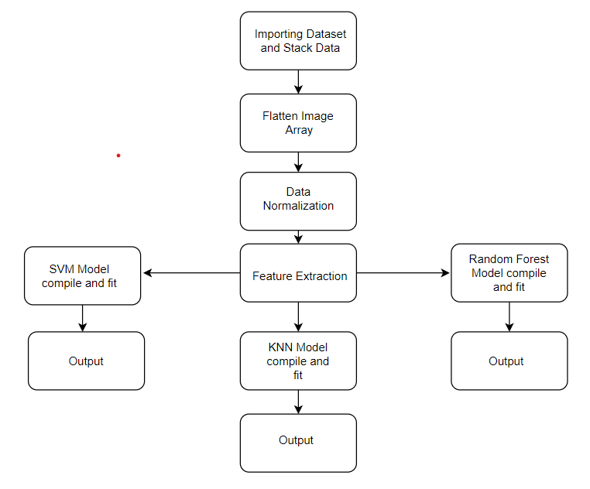
Flow Chart
Fig 4: Flow Chart For Classification and Clustering

Slide 13
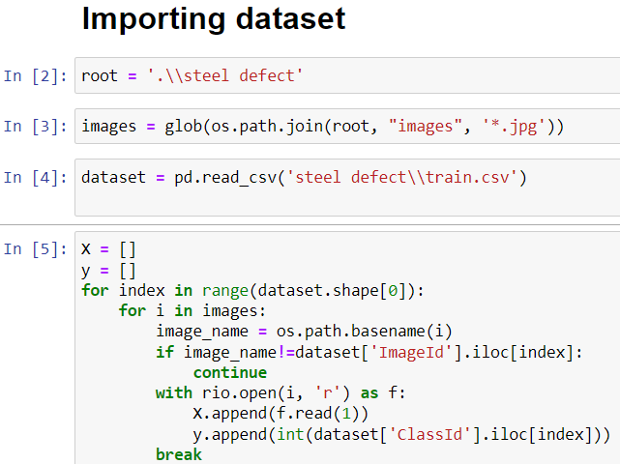
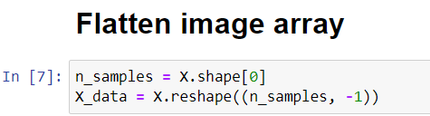
Step Analysis

Slide 14
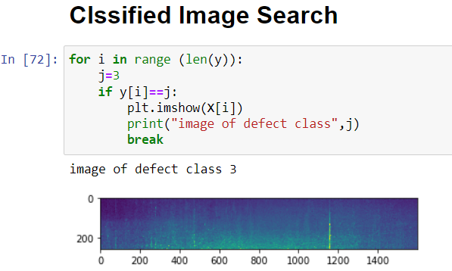
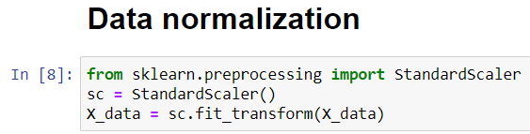
Step Analysis

Slide 15
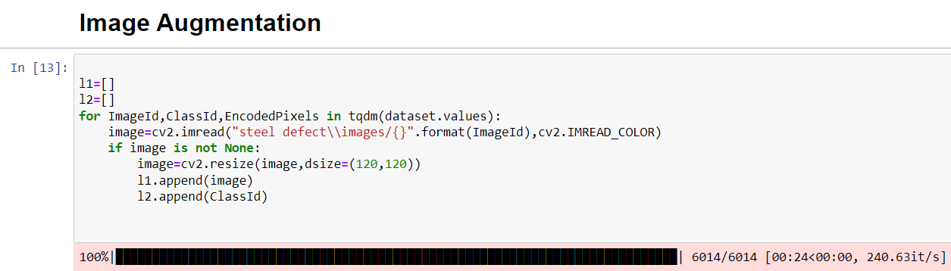
Step Analysis

Slide 16
Result Analysis
Accuracy Table:
No. | Model | Accuracy
1 | CNN | 75.81%
2 | Xception | 89.80%
3 | SVM | 75.80%
4 | Random Forest | 73.38%
5 | KNN | 75.48%

Slide 17
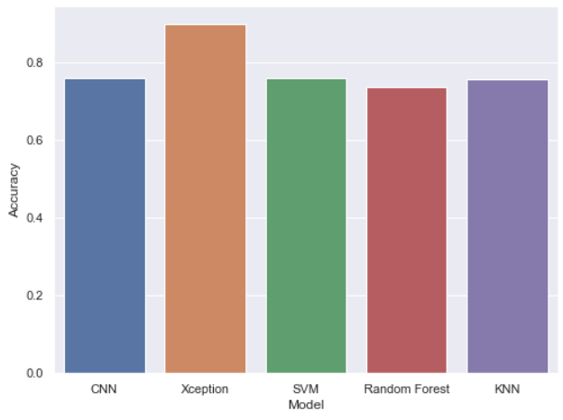
Result Analysis
Accuracy Bar Chart

Slide 18
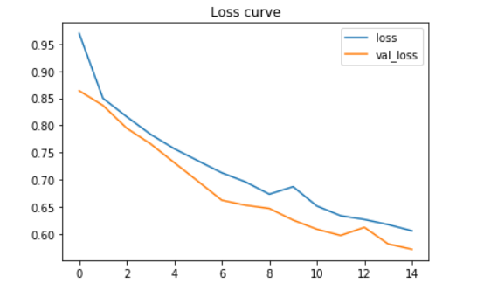
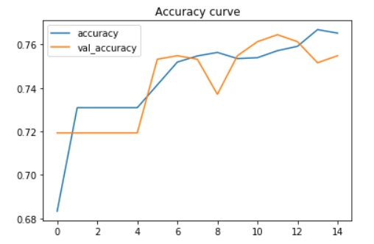
Result Analysis
CNN
Fig 4: Loss Curve
Fig 5: Accuracy Curve

Slide 19
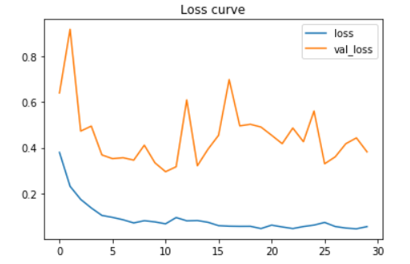
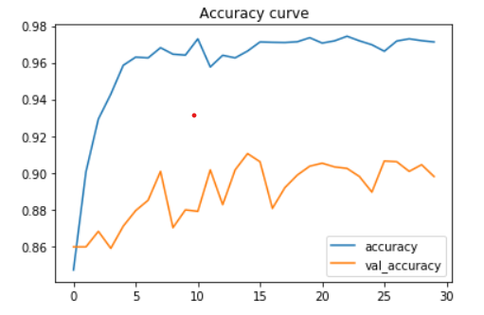
Result Analysis
Xception
Fig 6: Loss Curve
Fig 6: Accuracy Curve

Slide 20
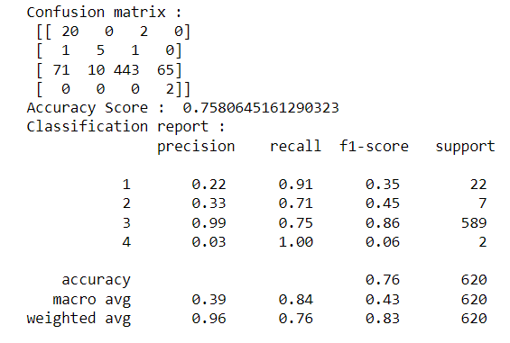
Result Analysis
SVM

Slide 21
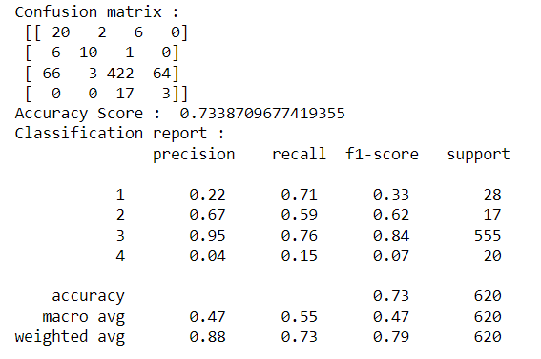
Result Analysis
Random Forest

Slide 22
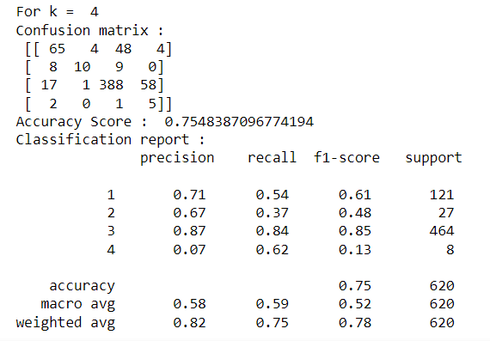
Result Analysis
KNN

Slide 23
Future Work
Due to the imbalance between different kinds of labels, more data augmentation processes such as rotation and scaling on the images should be performed on the rare defect classes.
Measure accuracy without reshaping size of image.
Measure accuracy with different size of image.
We can use multiple model in a single device to achieve more accurate result.

Slide 24
Conclusion
The models outputs the pixel wise defected area with corresponding labels. Among all the models, the task and compared their performance and achieved highest accuracy of 89.80% for Xception Model.

Slide 25
References
J. Long, E. Shelhamer, and T. Darrell. Fully convolutional networks for semantic segmentation. In Proceedings of the IEEE conference on computer vision and pattern recognition, pages 3431–3440, 2015.
L.-C. Chen, G. Papandreou, I. Kokkinos, K. Murphy, and A. L. Yuille. Deeplab: Semantic image segmentation with deep convolutional nets, atrous convolution, and fully connected crfs. IEEE transactions on pattern analysis and machine intelligence, 40(4):834–848, 2017
H. Noh, S. Hong, and B. Han. Learning deconvolution network for semantic segmentation. In Proceedings of the IEEE international conference on computer vision, pages 1520– 1528, 2015
R. Girshick. Fast r-cnn. In Proceedings of the IEEE international conference on computer vision, pages 1440–1448, 2015
T.-Y. Lin, P. Dollar, R. Girshick, K. He, B. Hariharan, and ´ S. Belongie. Feature pyramid networks for object detection. In Proceedings of the IEEE conference on computer vision and pattern recognition, pages 2117–2125, 2017

Slide 26
References
T.-Y. Lin, M. Maire, S. Belongie, J. Hays, P. Perona, D. Ramanan, P. Dollar, and C. L. Zitnick. Microsoft coco: Common objects in context. In European conference on computer vision, pages 740–755. Springer, 2014.
M. Cordts, M. Omran, S. Ramos, T. Rehfeld, M. Enzweiler, R. Benenson, U. Franke, S. Roth, and B. Schiele. The cityscapes dataset for semantic urban scene understanding. In Proceedings of the IEEE conference on computer vision and pattern recognition, pages 3213–3223, 2016.
Z. Zhang, A. G. Schwing, S. Fidler, and R. Urtasun. Monocular object instance segmentation and depth ordering with cnns. In Proceedings of the IEEE International Conference on Computer Vision, pages 2614–2622, 2015
Z. Zhang, S. Fidler, and R. Urtasun. Instance-level segmentation for autonomous driving with deep densely connected mrfs. In Proceedings of the IEEE Conference on Computer Vision and Pattern Recognition, pages 669–677, 2016.
B. Romera-Paredes and P. H. S. Torr. Recurrent instance segmentation. In European conference on computer vision, pages 312–329. Springer, 2016.

Slide 27
References
L. Shen, Z. Lin, and Q. Huang. Relay backpropagation for effective learning of deep convolutional neural networks. In European conference on
Severstal: Steel Defect Detection
F. Chollet. Xception: Deep learning with depthwise separable convolutions. In Proceedings of the IEEE conference on computer vision and pattern recognition, pages 1251–1258, 2017.

Slide 28
Thank You

